Slide 1
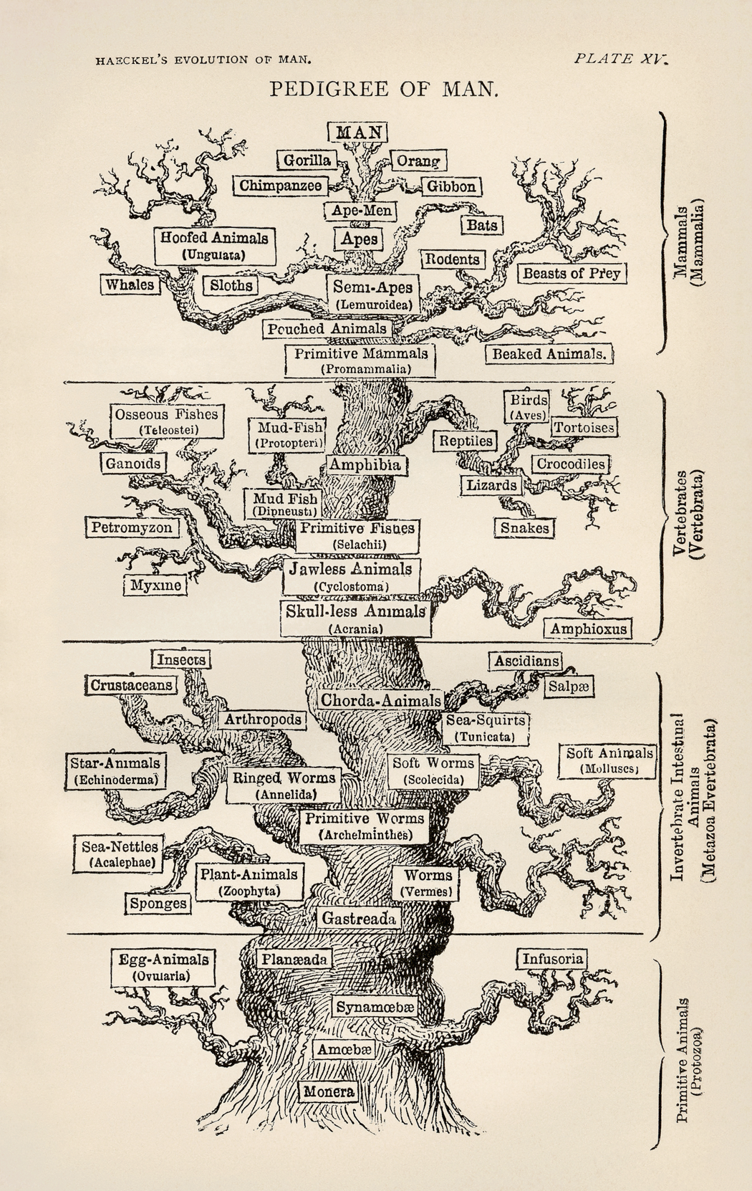

Phylogeny
Reconstruction
- a quick overview -
Notes:
Tree is from Ernst Haeckel, 1879

Slide 2
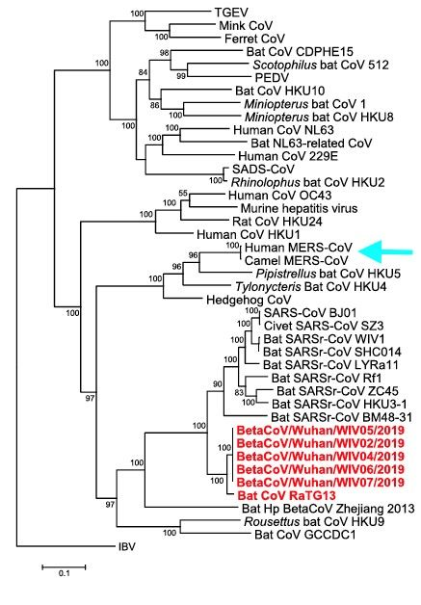
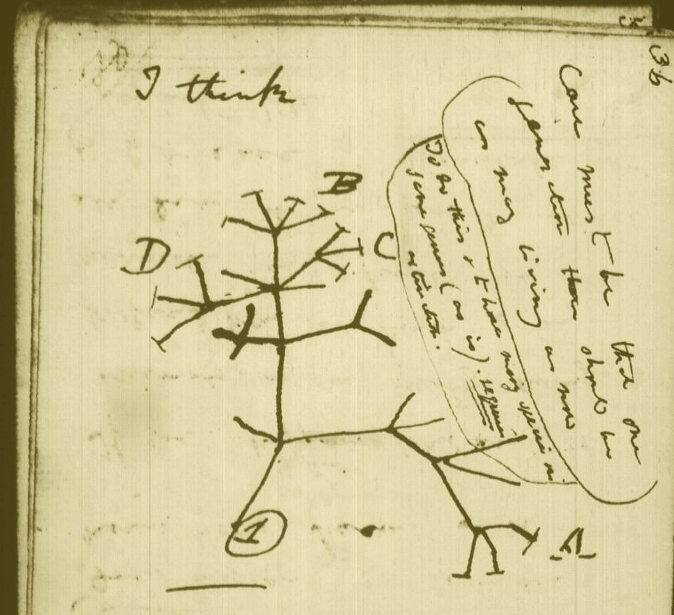
Some iconic phylogenetic trees
COVID-19 Coronavirus,
and closely related
animal viruses.
Charles Darwin, personal notebook
Notes:
https://www.sciencemag.org/news/2020/01/mining-coronavirus-genomes-clues-outbreak-s-origins#

Slide 3
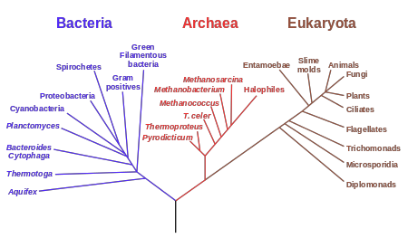
Some iconic phylogenetic trees
current, conventional version of the ‘tree of life’

Slide 4
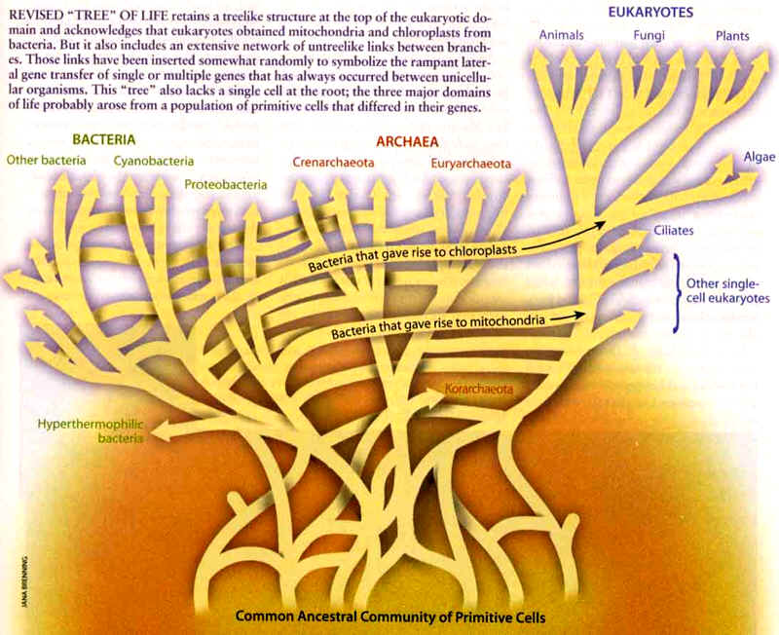
an alternative view,
emphasizing some problems

Slide 5
Generating phylogenetic trees
- from gene/protein sequences -
Phenetic: trees are constructed based on observed characteristics directly, not on evolutionary history
Cladistic: trees are constructed based on fitting observed characteristics to some model of evolutionary history
Distance
methods
Parsimony
and
Maximum
Likelihood
methods

Slide 6
Numer of topologies for m taxa
Unrooted tree
M Rooted tree UnRooted Tree
(2m-3)! / 2^{m-2}(m-2)! (2m-5)! / 2^{m-3}(m-3)!
1 1
3 3 1
4 15 3
5 105 15
6 945 105
7 10395 945
8 135135 10395
9 2027025 135135
10 34459425 2027025
A
C
B
D
Rooted Tree
O
A
B
C
D

Slide 7
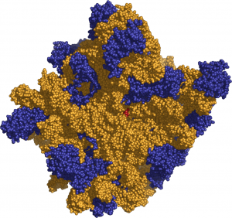
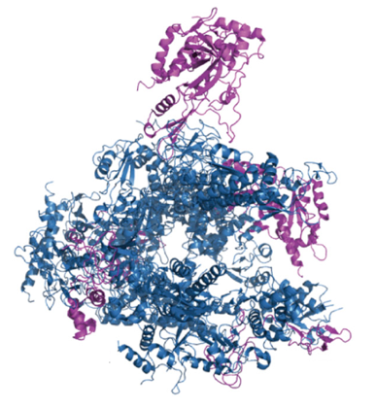
Which genes to use ?
suitable marker genes …
… should occur in every organism
… should rarely undergo horizontal transfer
… should be evolving ‘slowly’
… should only occur in one copy per genome
… should function in a process that sees no change
Polymerases
But, for recent events:
fast-evolving genes
Ribosomes
(RNA or proteins)

